Slide 1
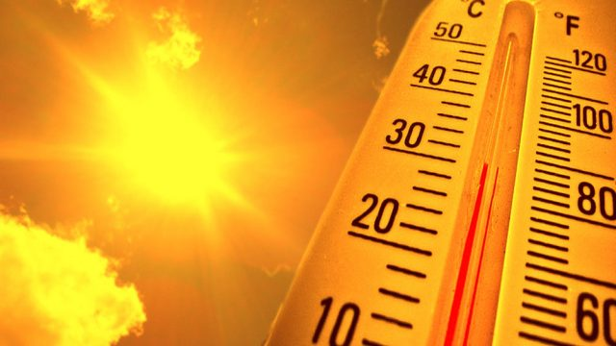
Global Warming: Average Global Temperature

Slide 2
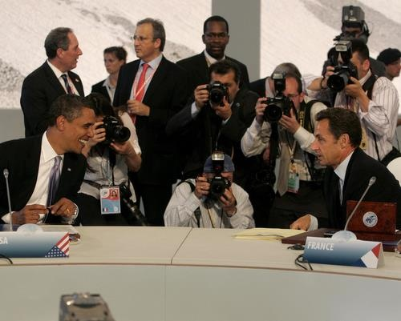
Global Leaders
“Agree”
in 2009.
Must stay below 2⁰ Celsius increase in Global Average Temperature.

Slide 3
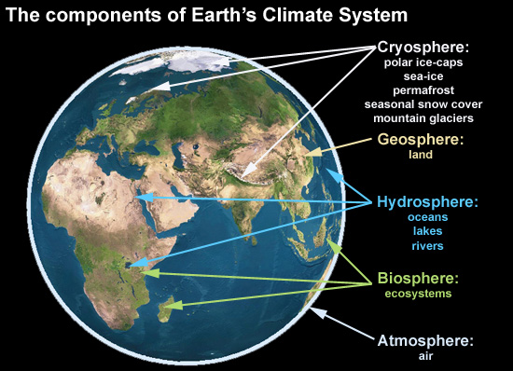
Earth’s climate is driven by complex, yet intricate interactions between the five Earth systems and solar radiation
Carbon dioxide could be affecting climate
https://skepticalscience.com//pics/climate-components.jpg

Slide 4
Dataset overview
Head (1958) | Temperature data (Change ⁰C ) | CO2 data (ppm)
March | 0.10 | 315.71
April | 0.01 | 317.45
May | 0.08 | 317.50
June | -0.05 | 315.86
July | 0.06 | 315.86
August | -0.06 | 314.93
Tail (2018) | Temperature data (Change ⁰C) | CO2 data (ppm)
May | 0.87 | 411.24
June | 0.82 | 410.79
July | 0.74 | 408.71
August | 0.79 | 406.99
September | 0.74 | 405.51
October | 0.99 | 406
0 = 13.9 ⁰C

Slide 5
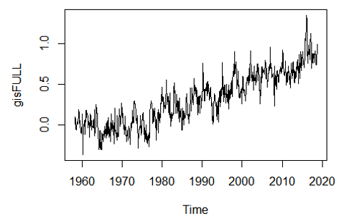
Dataset overview contd..

Slide 6
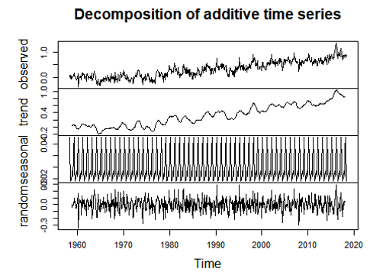
Notes:
The process is not stationary

Slide 7
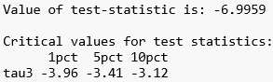

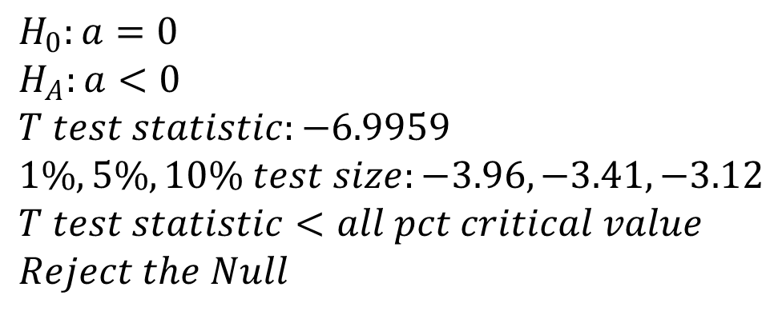
Transformation tests (Log & Unit root test)
$$H_{0}:a=0$$
$$H_{A}:a<0$$
$$T test statistic:−6.9959$$
$$1\%, 5\%, 10\% test size:−3.96, −3.41, −3.12$$
$$T test statistic<all pct critical value$$
$$Reject the Null$$

Slide 8
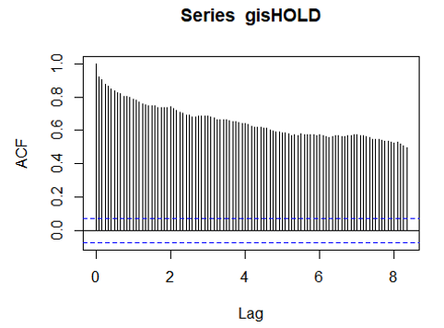
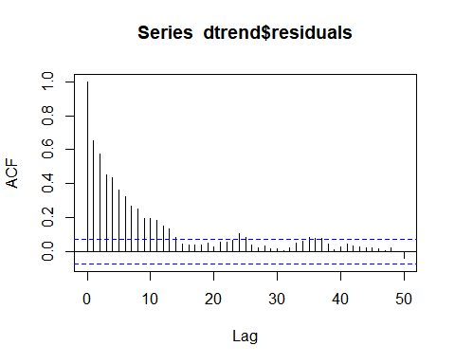
Transformation tests (Differentiation)

Slide 9
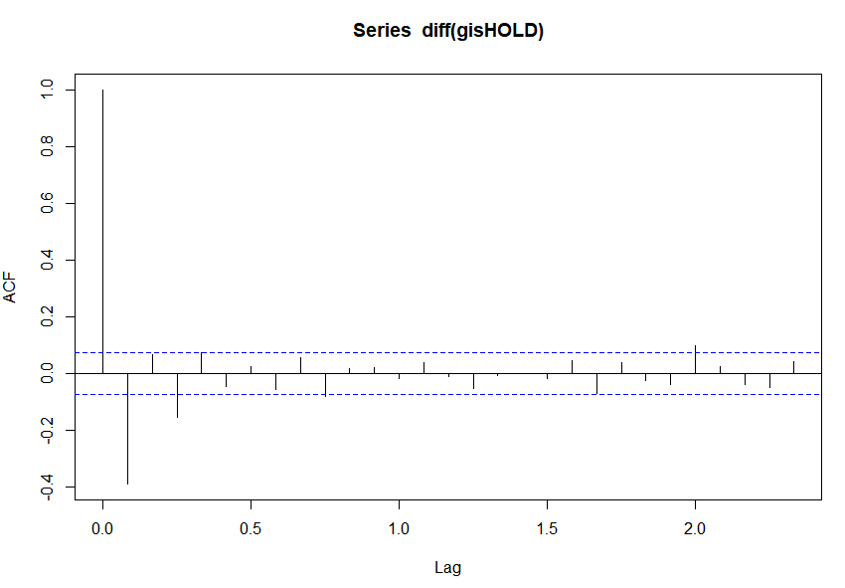
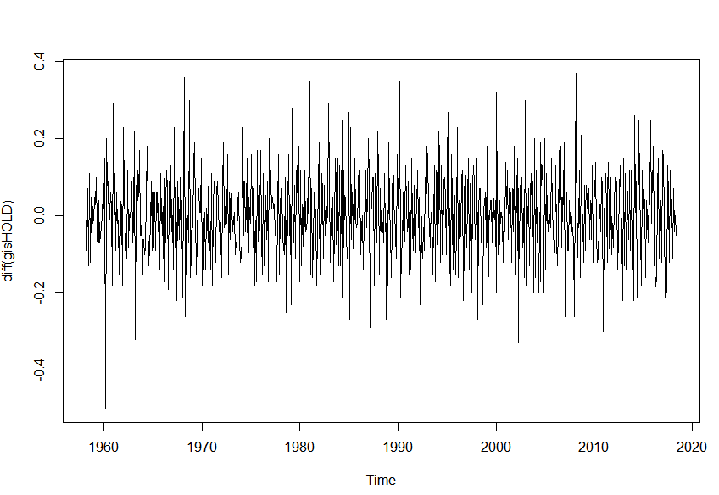
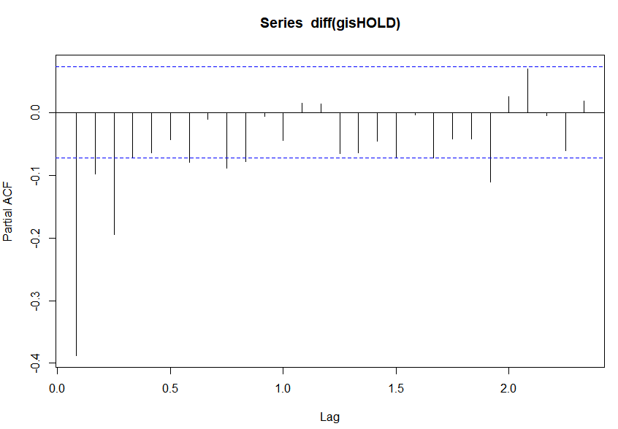
Transformation tests (Differentiation)

Slide 10
Model estimation: SARIMA
 | Model (p, d, q) (P, D, Q) | SIC | AIC
Initial | (1,1,0) (1,0,0) | -1082.47 | -1100.8
Trial 1 | (1,1,1) (1,0,0) | -1110.81 | -1133.72
Trial 2 | (1,1,2)(1,0,0) | -1133.54 | -1161.04
Trial 3 | (2,1,1)(1,0,0) | -1162.81 | -1135.31
Final | (2,1,1) (1,0,2) | -1133.03 | -1169.69

Slide 11
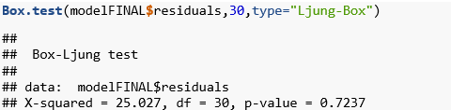
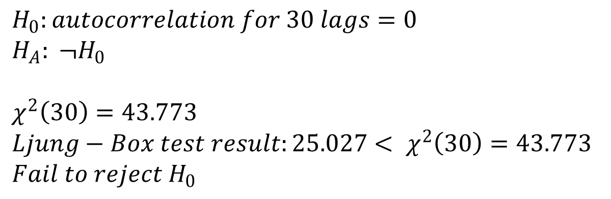
Ljung-Box Test
$$H_{0}:autocorrelation for 30 lags=0$$
$$H_{A}: ¬H_{0}$$
$$χ^{2}\left(30\right)=43.773$$
$$Ljung−Box test result:25.027< χ^{2}\left(30\right)=43.773$$
$$Fail to reject H_{0}$$

Slide 12
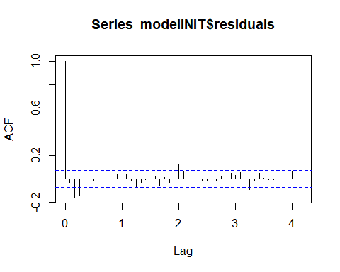
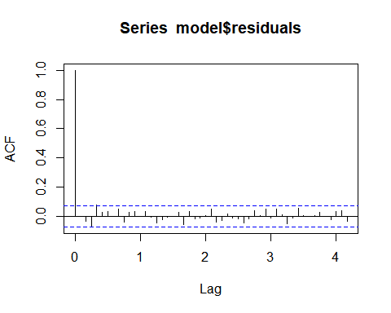
ACF (Initial vs. Final Model)

Slide 13
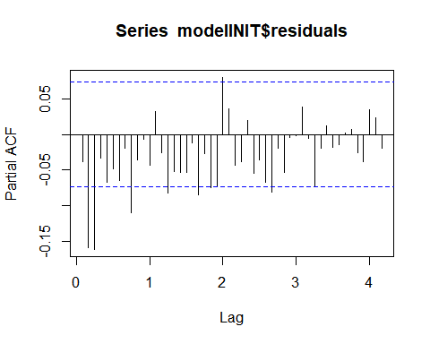
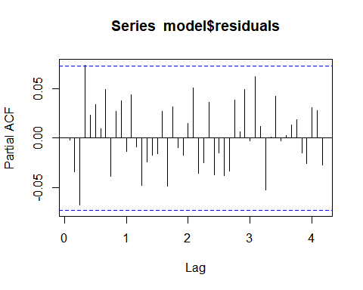
Partial ACF (Initial vs. Final Model)

Slide 14
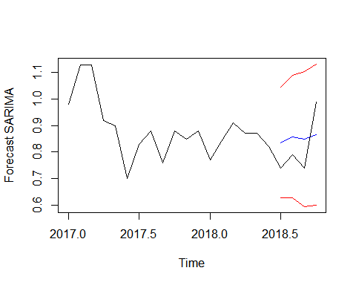
Forecast SARIMA

Slide 15


VAR selection

Slide 16
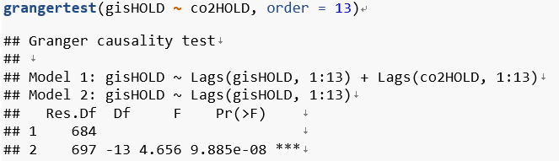
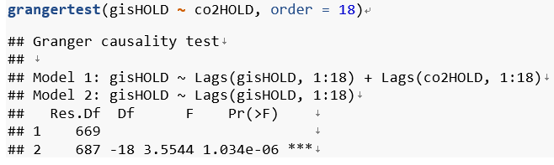
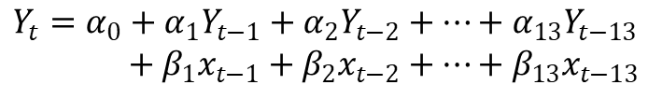
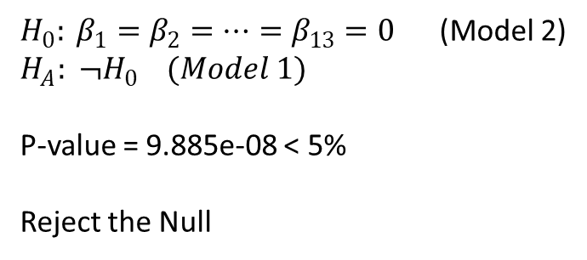
VAR (Granger Causality test)
$$Y_{t}=α_{0}+α_{1}Y_{t−1}+α_{2}Y_{t−2}+…+α_{13}Y_{t−13}$$
$$+ β_{1}x_{t−1}+β_{2}x_{t−2}+…+β_{13}x_{t−13}$$
$H_{0}: β_{1}=β_{2}=…=β_{13}=0$ (Model 2)
$$H_{A}: ¬H_{0} (Model 1)$$
P-value = 9.885e-08 < 5%
Reject the Null

Slide 17
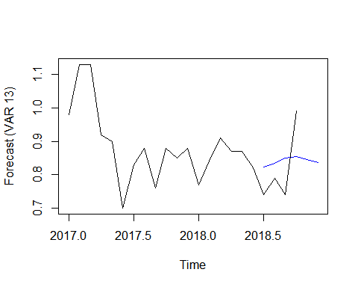
Forecast VAR

Slide 18
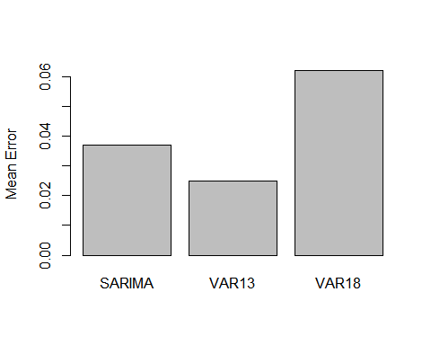
Accuracy (SARIMA vs. VAR)
accuSARIMA = accuracy(realDATA, foreSARIMA[1:4]) accuVAR13 = accuracy(realDATA, meanVAR13[1:4]) accuVAR18 = accuracy(realDATA, meanVAR18[1:4])
 | Mean Error
SARIMA | 0.0369685
VAR13 | 0.02490881
VAR18 | 0.06212434
Notes:
The forecasting error is low in VAR 13

Slide 19
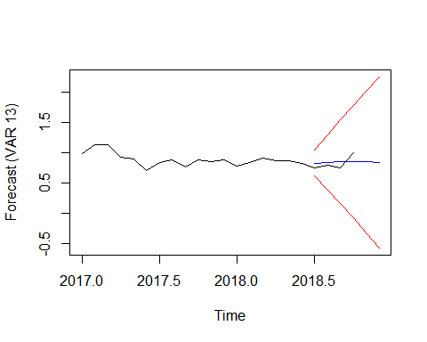
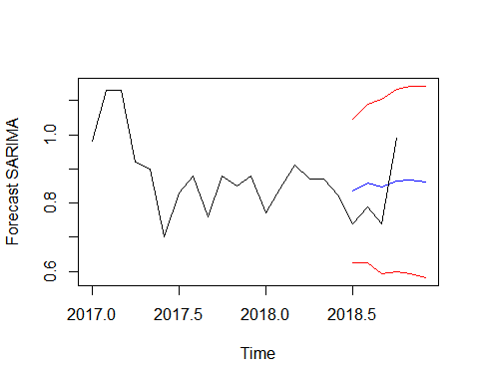
Confidence Interval (SARIMA vs. VAR)
Notes:
The confidence intervals are wider

Slide 20
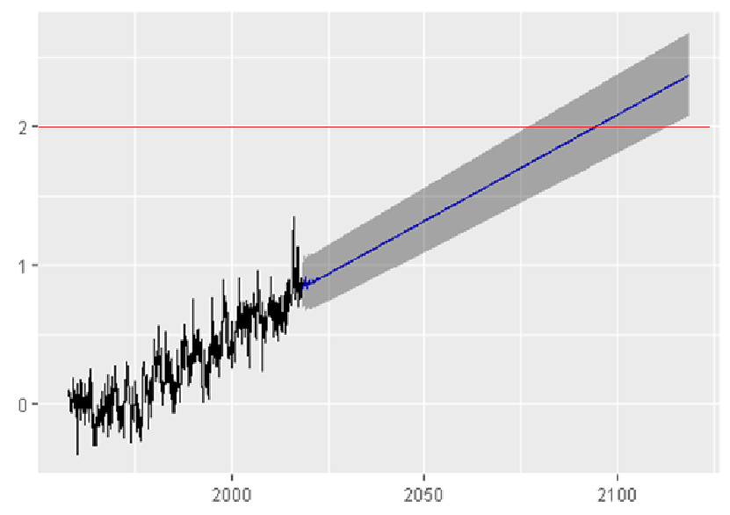
Dooms Day??
> 2.0 degree Celsius | Year | Month
Upper | 2069 | Jan
Point | 2094 | April
Lower | 2124 | September

Slide 21
Cumming, Vivien. “Earth - How Hot Could the Earth Get?” BBC News, BBC, 30 Nov. 2015, www.bbc.com/earth/story/20151130-how-hot-could-the-earth-get. Treat, Jason. “What the World Would Look Like If All the Ice Melted.” National Geographic, National Geographic, 18 Sept. 2017, www.nationalgeographic.com/magazine/2013/09/rising-seas-ice-melt-new-shoreline-maps/#/01-ice-melt-north-america.jpg. Tarbuck, Edward J. et al. Earth: An Introduction to Physical Geology. Pearson, 2017 Lindsey, Rebecca, and Luann Dalman. “Climate Change: Global Temperature.” Climate Change: Global Sea Level | NOAA Climate.gov, 1 Aug. 2018, www.climate.gov/news-features/understanding-climate/climate-change-global-temperature.
Work cited:

